Slide 1
Cog4Sol Cognition-driven predictive maintenance of Solar power plants
D3 Final Dissemination, Communication and Exploitation material

Slide 2
Partners
Nissatech is an innovation-driven SME with strong international cooperation and vision to become one of European top innovators in the domain of advanced AI and cognitive industrial solutions.
Vision: International leader in offering concepts and technologies for exploiting the full potential of the data-driven business, by accepting own social and environmental responsibility
Approach: intelligent data processing contextualized with process analysis and enriched with domain knowledge/expertise
Technologies: Big data, Real-time processing, AI
The Business Technology Incubator of Technical Faculties Belgrade (BITF) is the first and leading business technology incubator in Serbia, established in year 2006.
BITF is founded as a result of collaboration between four distinguish technical faculties of the University of Belgrade (Faculty of Electrical Engineering, Faculty of Mechanical Engineering, Faculty of Civil Engineering and Faculty of Technology and Metallurgy), local municipal government and the Democratic Transition Initiative, NGO.

Slide 3
Cog4Sol
VISION: to create a new generation of the predictive maintenance solutions for middle-sized solar power plants which use the advanced AI and data analytics methods for predicting/analysing not only the trends in generated solar energy, but also the status of the entire solar and manufacturing infrastructure enabling a holistic predictive maintenance.
INNOVATION: Modelling normal behaviour of the asset (infrastructure) using advanced analytics based on the existing solutions for advanced modeling by the technology provider.

Slide 4
Main Outcomes
There are two main exploitable results (outcomes):
The system (SaaS) for holistic predictive maintenance for solar power systems.
Delivered as SaaS
The CPS-based infrastructure for easy deployable sensing and monitoring for sustainable manufacturing.
Delivered as an HW-SW system

Slide 5
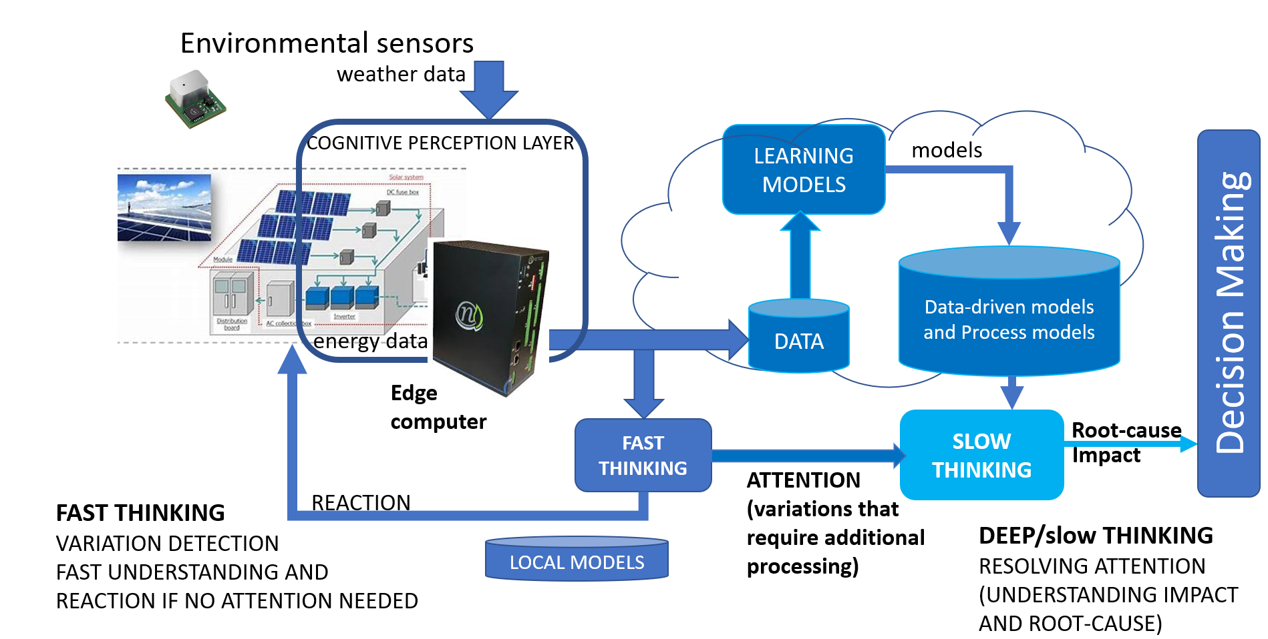
Architecture

Slide 6
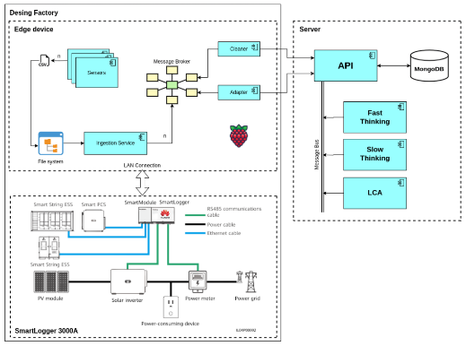
Energy production Architecture
Sensing and processing the data about energy consumption
Sensing and processing the data about energy production
Server-side data analysis

Slide 7
Sensor service
Power Power source gateway service is a service that continuously collects data from multiple power sensors. The sensors measure and record the power consumption data at regular intervals, usually every second. The power source service then processes this data and aggregates it into one comprehensive report.
Environment Environment sensor service is a data collector for environmental data. Environmental data concerns basic atmospheric information and advanced information about Air Quality Index. The service collects data from several sensors by writing and reading addresses from sensors registers for data collection, aggregate data and in .csv format store data in file system. Besides storing in file system environment service reports ingestion service with POST request about file path of .csv file.

Slide 8
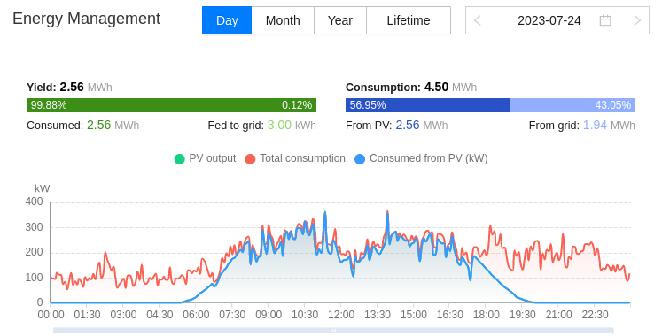
Architecture – SmartLogger
Huawei Logger

Slide 9
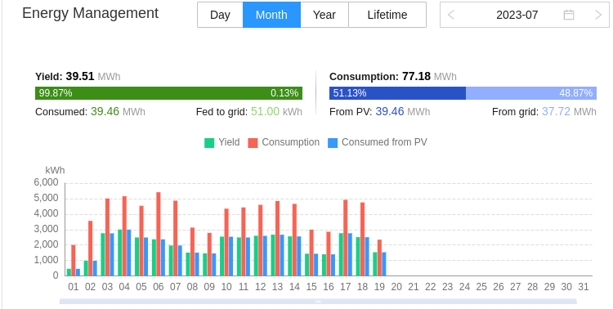
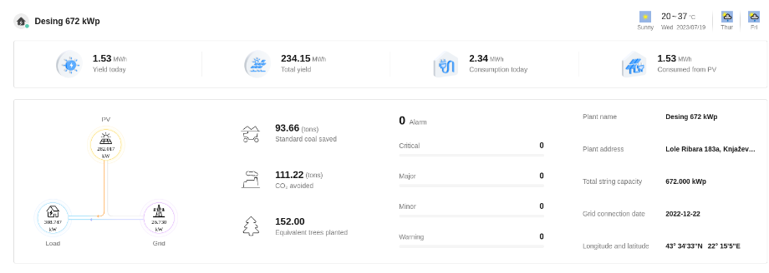
Architecture – SmartLogger
Huawei Logger

Slide 10
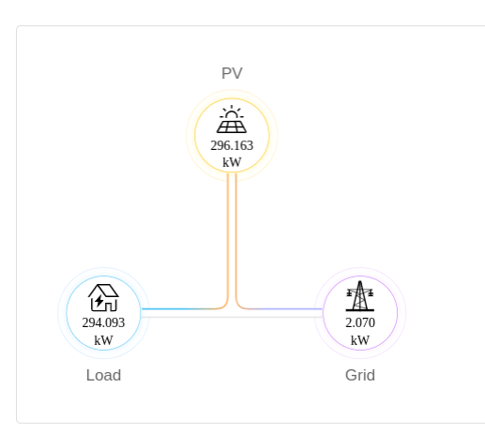
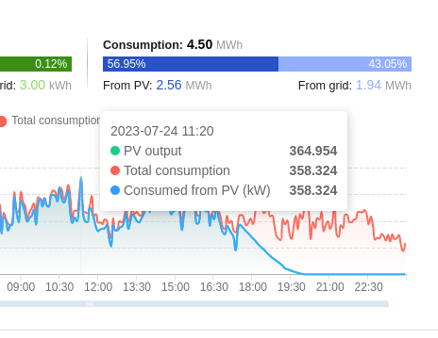
Architecture – SmartLogger
Huawei Logger
The above images show room for improvement, PV output was larger than total consumption of the factory, basically throwing away free energy yielded from the sun – Desing installation of PV panels has 672 kWp* (with 8 hours of sun they could generate ~5MWh per day) and their maximum daily (peak, per one hour) consumption goes only up to 400 kWh totaling to ~5 MWh per day.

Slide 11
Data analysis: energy production
Dataset

Slide 12
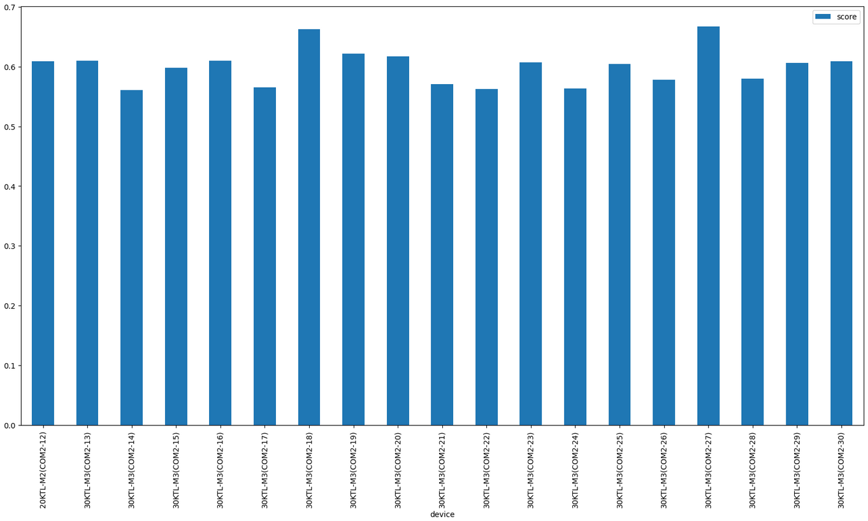
Data analysis: energy production
Coefficients of variations of inverters performance

Slide 13
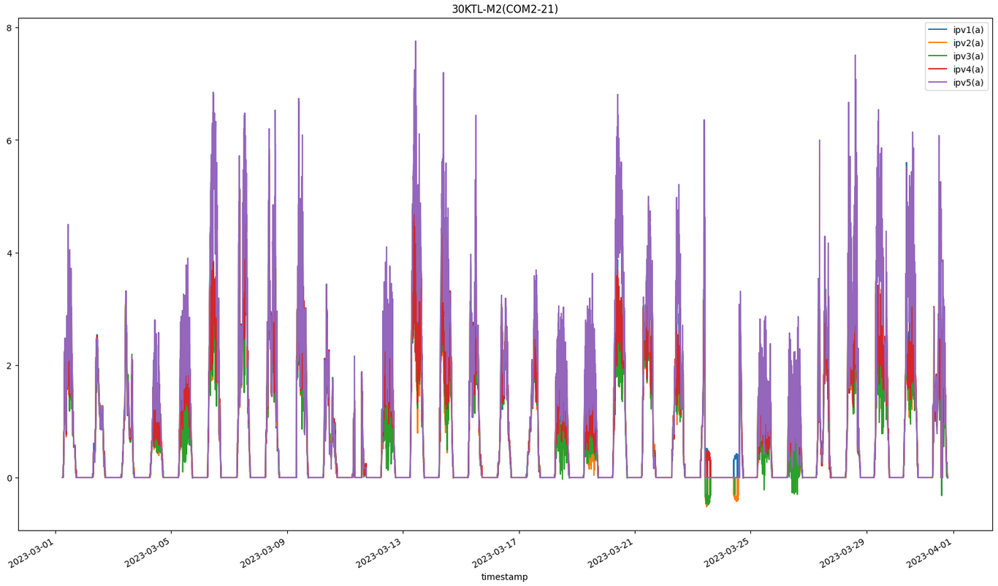
Data analysis: energy production
Maximum power point currents for every string

Slide 14
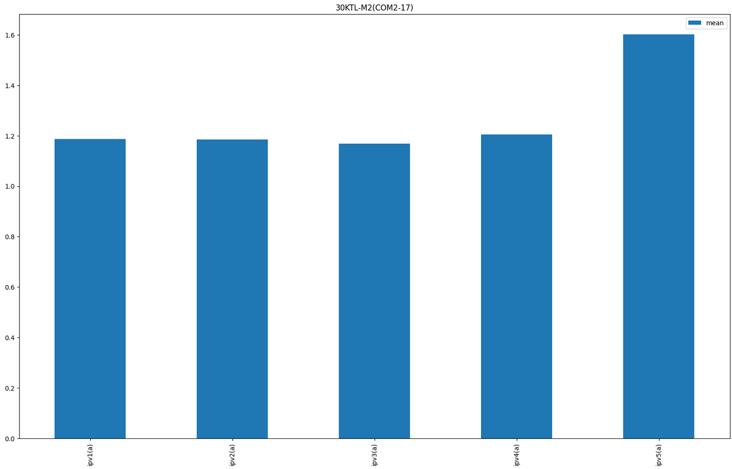
Data analysis: energy production
The mean of currents in every string of inverter (COM2-21)

Slide 15
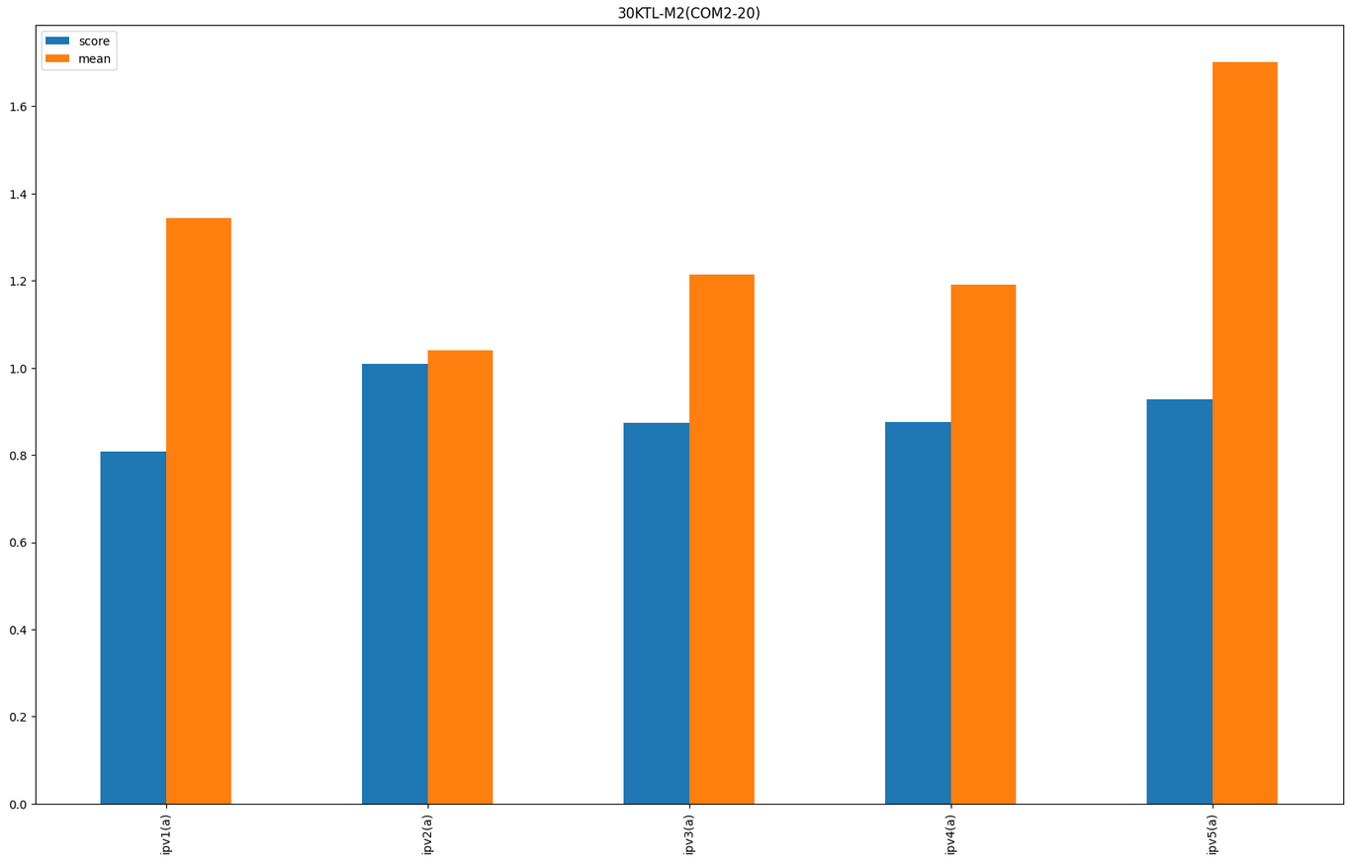
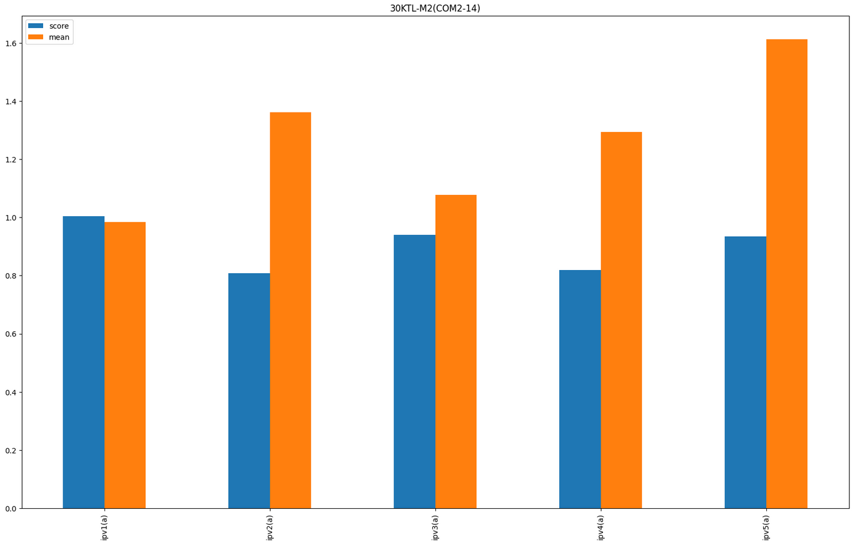
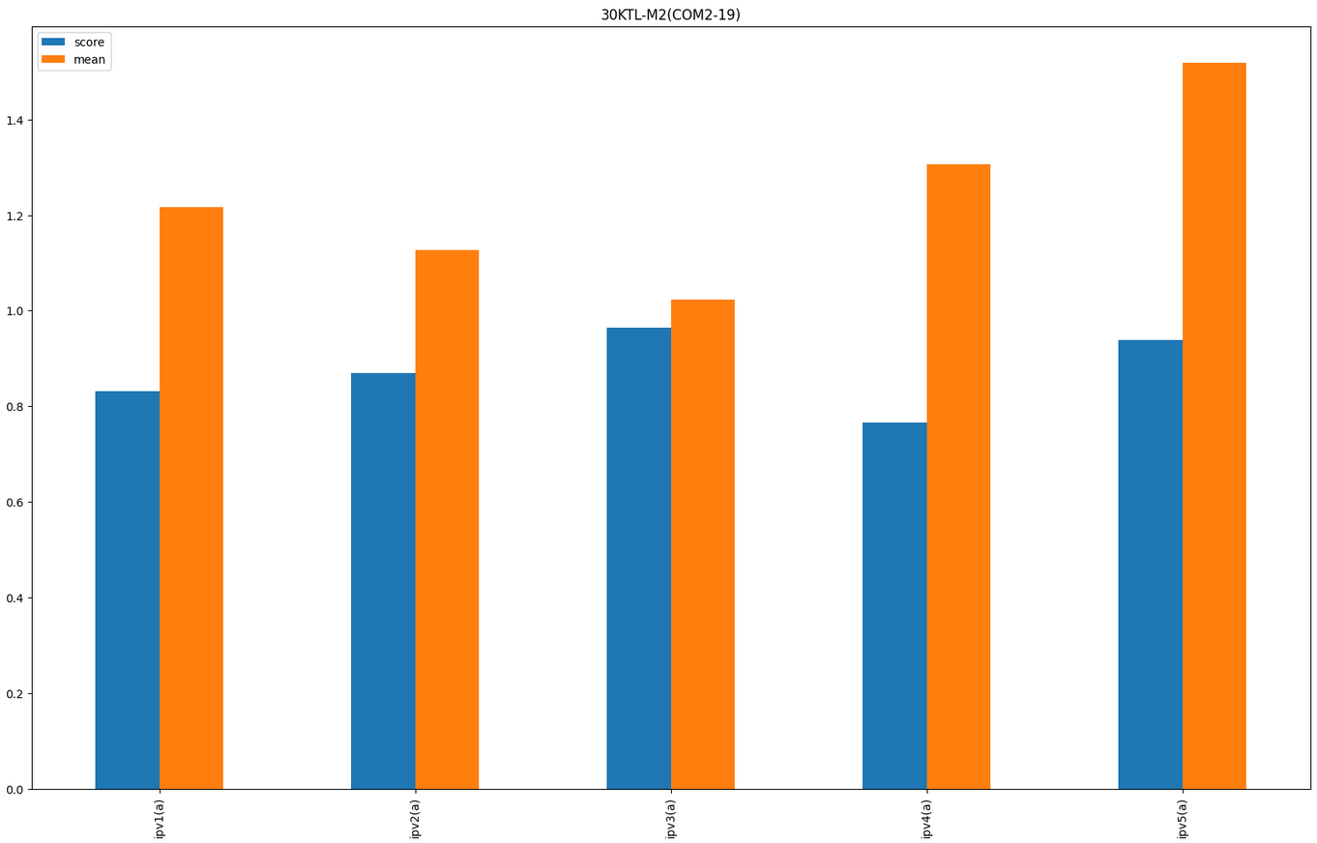
Data analysis: energy production
The means and coefficients of variations for every string current (COM2-20)
COM2-14
COM2-19
Variations
string 2 in COM2-20,
string 1 in COM2-14,
string 3 in COM2-19.
These 3 strings have lower power production and bigger variation in this month period. That can be regular, but also can point out some possible instabilities

Slide 16
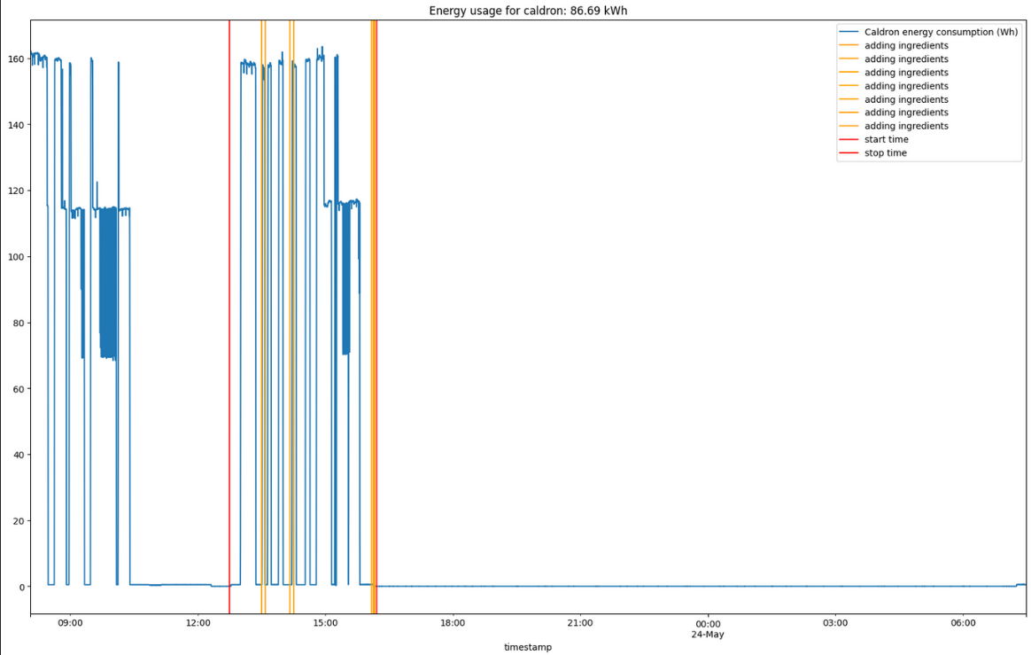
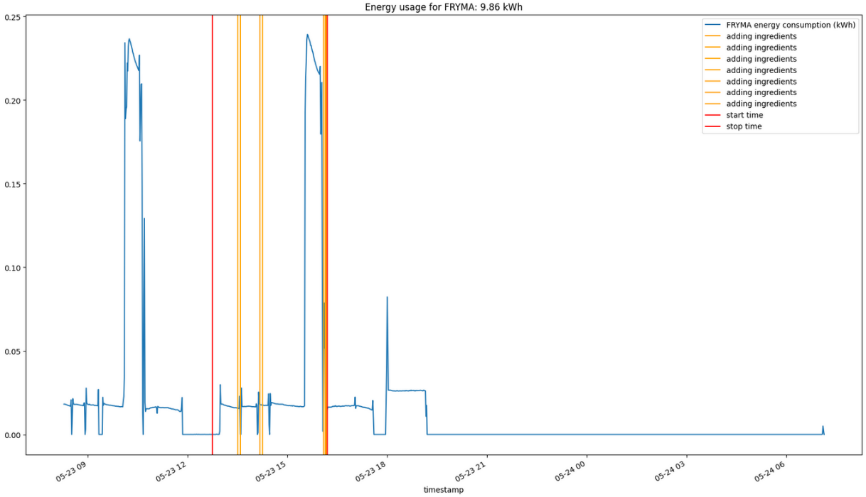
Data analysis: production analysis
Energy consumption of caldron
Energy consumption of FYRM

Slide 17
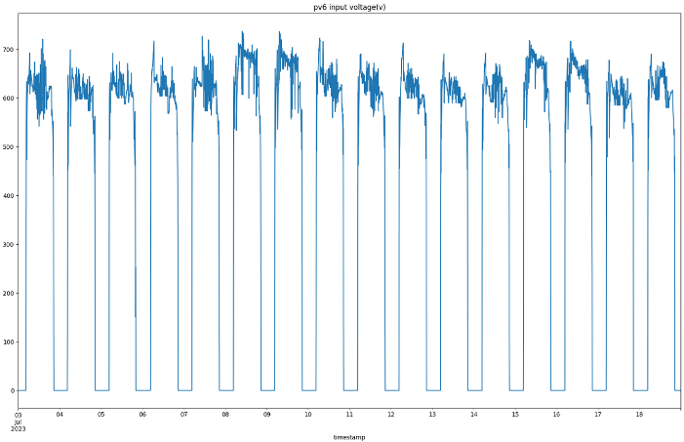
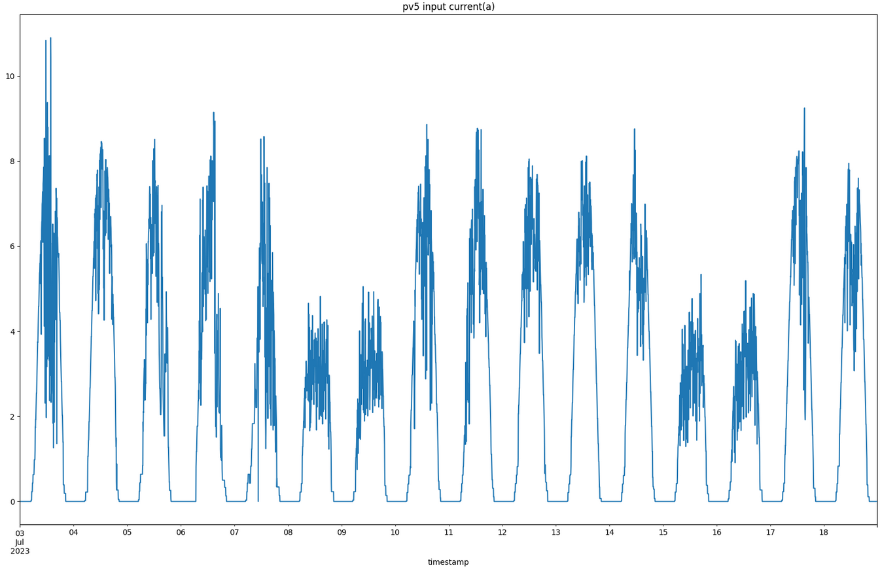
Data analysis: production analysis
Current for PV 6 of one inverter
Current of PV 5 of one inverter

Slide 18
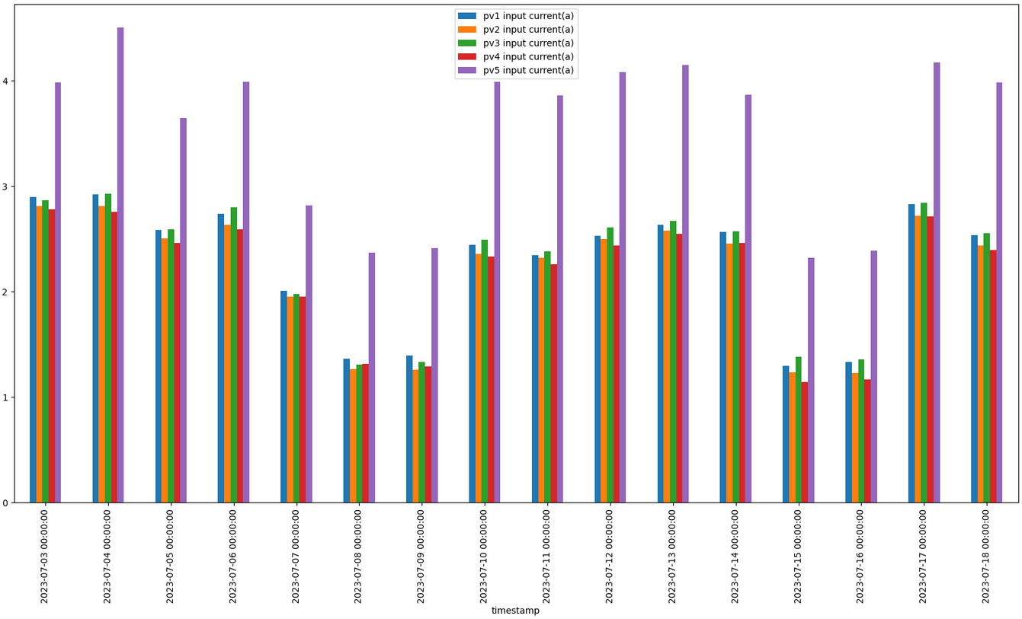
Data analysis: production analysis – relevant for maintenance
The currents in PV panels for inverter
PV panel 5 can produce nearly 30% more energy than the rest of the panels individually.

Slide 19
Data analysis: manufacturing process
The goal of this analysis is to define the normal behaviour of the system. Any behaviour which is not corresponding to the normal behaviour is treated as anomalous one.
We define data-driven behavioural models, which are learned from data, usually using some clustering methods.
Main goal for the usage of energy sensors is to understand when the demand for energy is increasing: in which parts of the day / production
In addition, energy sensors can be used for detecting the operational modes of machines automatically.
This is the reason why our approach can be used in an unsupervised manner – we can label the datasets automatically.

Slide 20
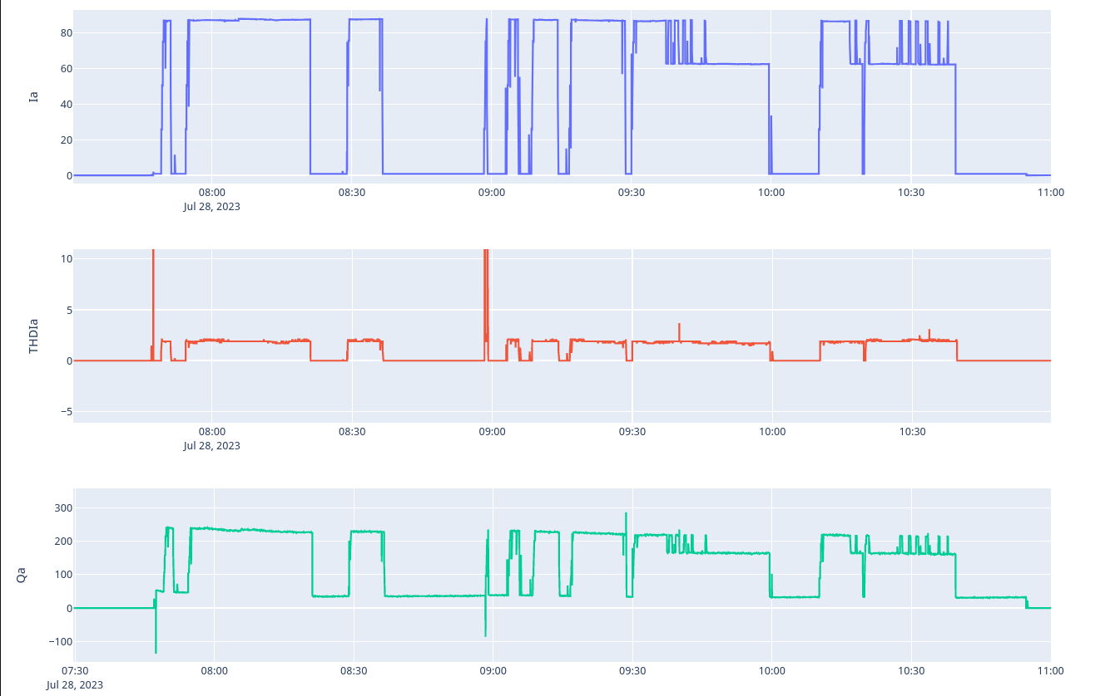
Data analysis: manufacturing process
Signal behavior for boiling water in caldron
THDI is very small here (except for temporary peaks), because in this process we have only heaters with basically only resistive impedance, so there is almost nothing to inject distortion in electric current.
Big electric current, around 60A, is necessary for heaters
Reactive power is small

Slide 21
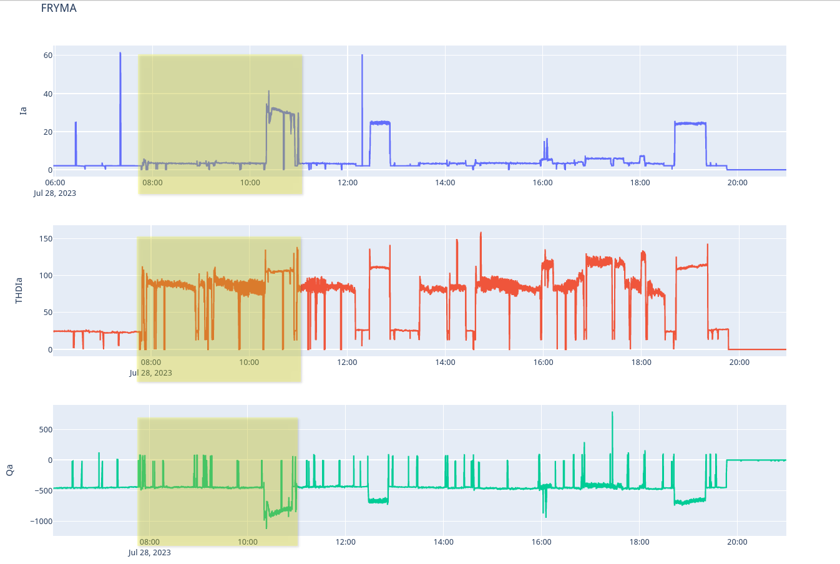
Data analysis: manufacturing process
Signal behavior for FRYMA motor
THDI is much larger, around 100%, even before working mode, we have 20, 30% of distortion, which is a big number.
Reactive power is here negative, which is unusual. That indicates they can have some capacitors batteries or something like that for reactive power compensation.

Slide 22
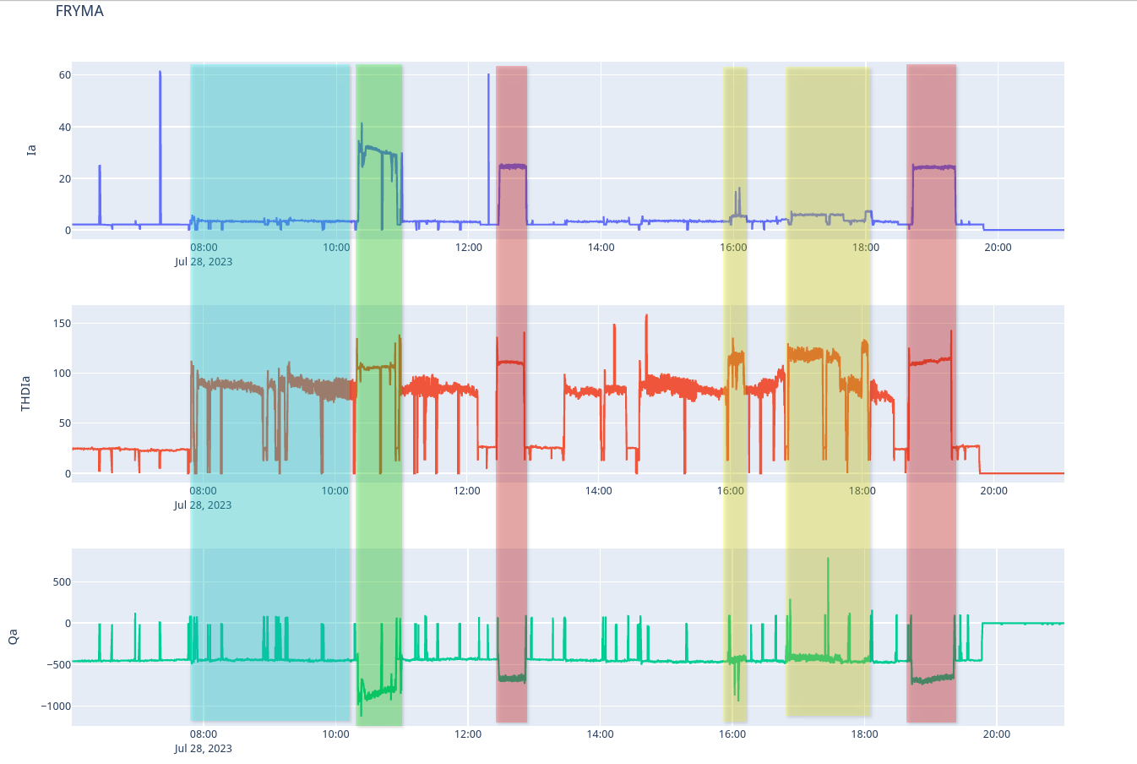
Data analysis: manufacturing process
Working modes for FRYMA motor
The blue period, machine started to work, not sure exactly what, but current increasing and drastic THDI increasing.
The green period with a much bigger electric current (almost 10 times bigger), but what is interesting is that distortion in current is just slightly bigger.
The red period is similar to green, but with smaller current and bigger distortion, which is not good for the electric grid.
The yellow period represents a working mode that is more similar to blue but has bigger current and bigger distortion (THDI).

Slide 23
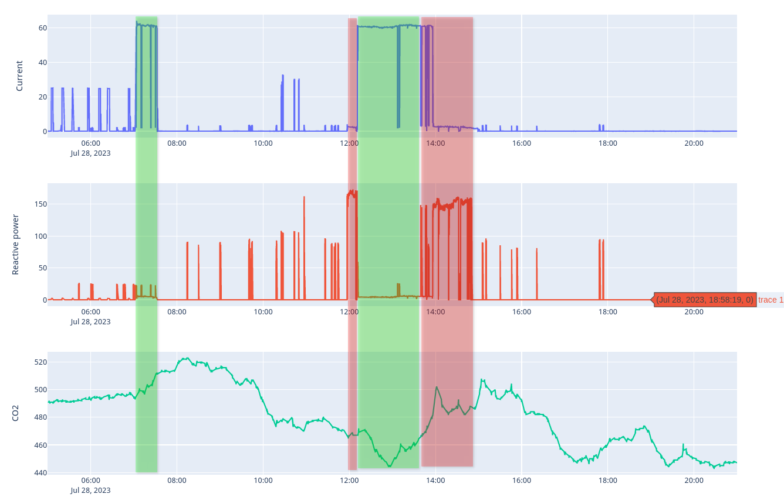
Data analysis: manufacturing process
Signal behavior of CO2 emission during selected operation modes
CO2 emission rises right after green operation mode, but also during red operation mode. This shows us that some of these operation modes have a big impact on CO2 emission, but which one is yet to be discovered with further analysis

Slide 24
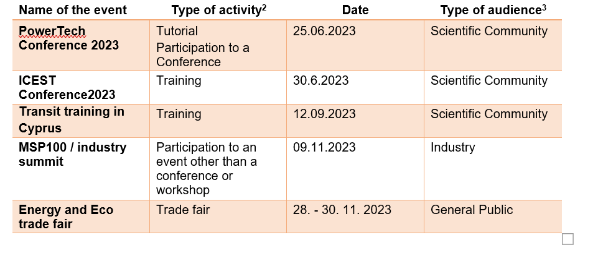
Promotion activities done
Awareness creation started

Slide 25
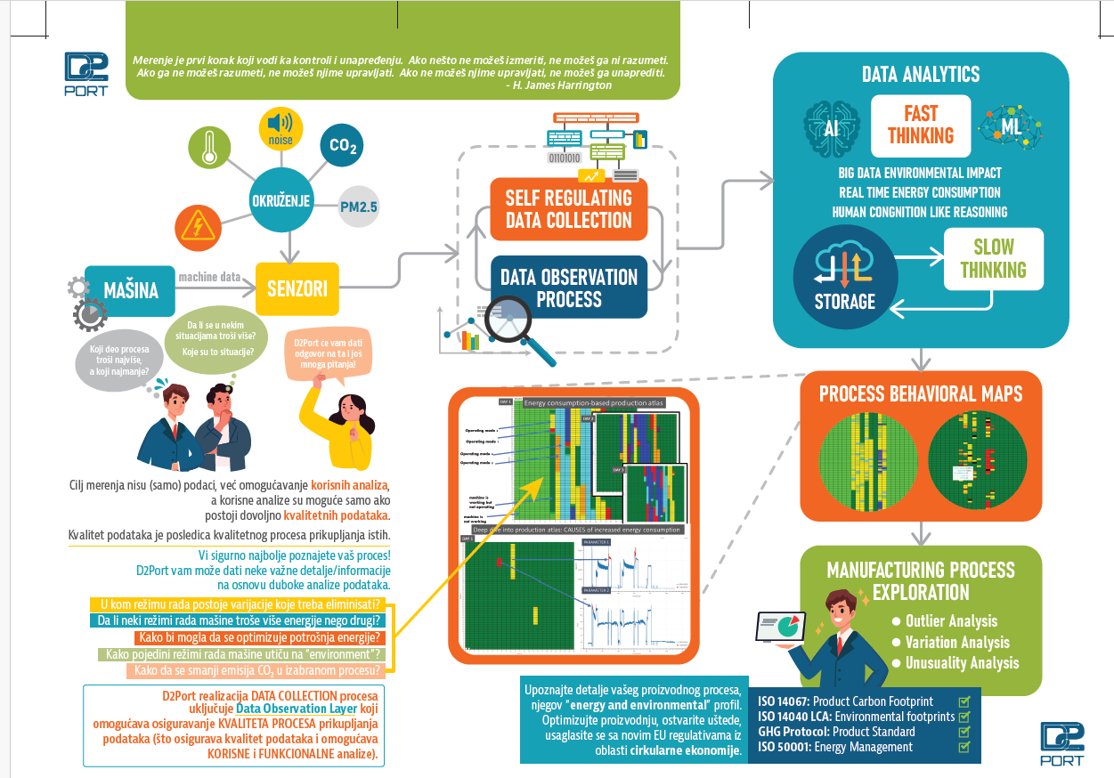
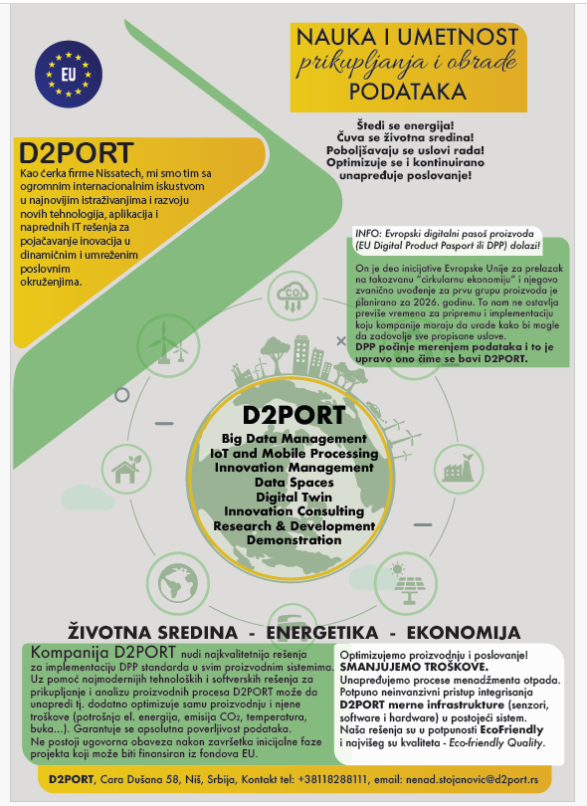

Slide 26
THANKS for the attention

